Slide 1
N-Rings
Reference:
http://simonsays-tw.com/web/NineLinkedRings/NineLinkedRings.html

Slide 2
Problem: N-Ring is a game, in which N rings are put on a stick in order, and the rings affect each other following the rules below:
  The first ring can be put on and taken off at any time.
  If you want to put on or take off the N-th ring, you have to put on the (N-1)-th ring, and take off all the rings from the 1-st to (N-2)-th. By doing so, you can put on or take off the N-th ring.
  Our goal is to take off all the rings.

Slide 3
Thinking Recursively
“Recursive approach”: A recursive approach to a problem consists of two parts:
  Recursive step: the problem is reduced to one or more problems of the same kind which are simpler in some sense.
  Basis (the simplest) step: there is a set of simplest problems to which all others are reduced after one or more steps. Solutions to these simplest problems are given.

Slide 4
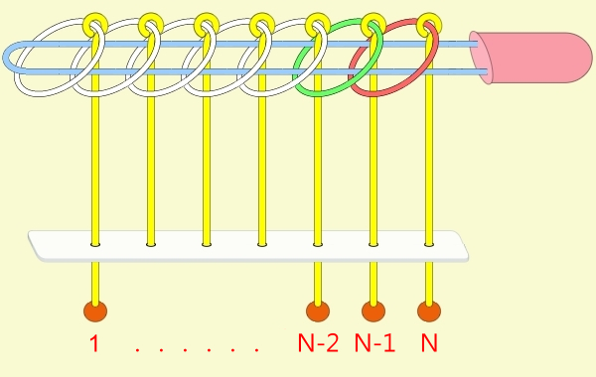
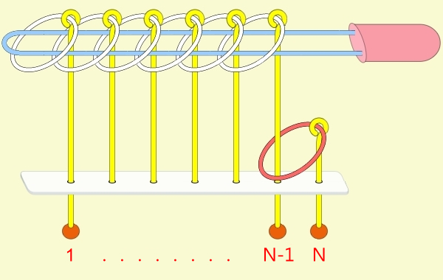
All N Rings Out: Recursive Step
How to reduce the original problem “all N rings out” into one or more simpler problems of the same kind?
Consider how to reduce the “all N rings out” problem into the “all N-1 rings out” problem.

Slide 5
All N Rings Out: Recursive Step (1/4)
How to reduce the “all N rings out” problem into the “all N-1 rings out” problem?
  Note Rule 2: If you want to put on or take off the N-th ring, you have to put on the (N-1)-th ring, and take off all the rings from the 1-st to (N-2)-th.
Step 1: Here, “take off all the rings from the 1-st to (N-2)-th” is another simpler problem of the same kind, i.e., “all N-2 rings out”.

Slide 6
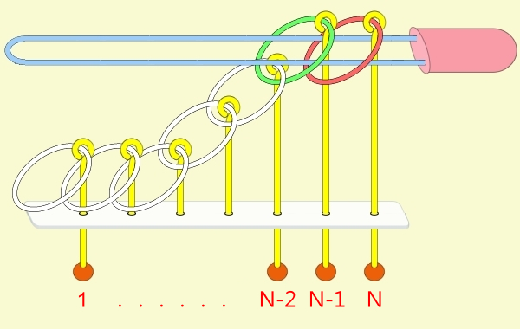
All N Rings Out: Recursive Step (1/4)

Slide 7
All N Rings Out: Recursive Step (2/4)
How to reduce the “all N rings out” problem into the “all N-1 rings out” problem?
  Note Rule 2: If you want to put on or take off the N-th ring, you have to put on the (N-1)-th ring, and take off all the rings from the 1-st to (N-2)-th.
Step 2: Then, “take off the N-th ring” directly

Slide 8
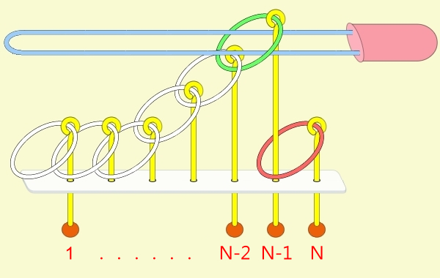
All N Rings Out: Recursive Step (2/4)

Slide 9
All N Rings Out: Recursive Step (3/4)
How to reduce the “all N rings out” problem into the “all N-1 rings out” problem?
Step 3:
  Note that, after Step 2, the arrangement becomes “only ring N-1 is in”.
  However, what we want is the “all N-1 rings out” problem, where “rings 1,…, N-1” should initially be in.
  What can we do?
    Move “rings 1,…, N-2” back in again using a separate function, which is also recursively defined.

Slide 10
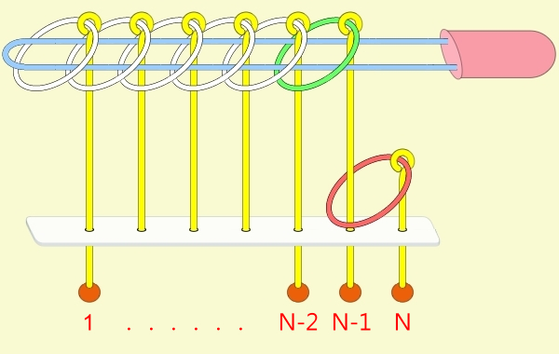
All N Rings Out: Recursive Step (3/4)

Slide 11
All N Rings Out: Recursive Step (4/4)
How to reduce the “all N rings out” problem into the “all N-1 rings out” problem?
Step 4:
  Finally, we have reduced the original problem into “all N-1 rings out” problem,
    which can then be solved by calling the function itself with problem size N-1.

Slide 12
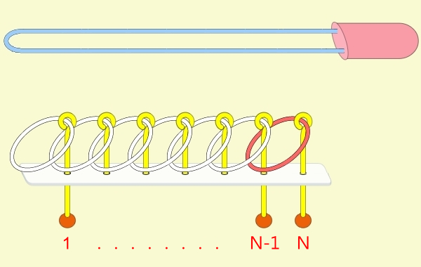
All N Rings Out: Recursive Step (4/4)

Slide 13
The out(int) function
void out(int n)
{
if(n < 1) return;
out(n-2);
printf("Move ring %d out\n", n);
in(n-2);
out(n-1);
}

Slide 14
All N Rings In: Recursive Step
Similarly, we can reduce the “all N rings in” problem into the following sub-problems:
  Sub-problem 1: Put on “rings 1,…, N-1”
  Sub-problem 2: Take off “rings 1,…, N-2”
  Sub-problem 3: Put on ring N
  Sub-problem 4: Put on “rings 1,…, N-2”

Slide 15
All N Rings In: Sub-problem 1

Slide 16
All N Rings In: Recursive Step
Similarly, we can reduce the “all N rings in” problem into the following sub-problems:
  Sub-problem 1: Put on “rings 1,…, N-1”
  Sub-problem 2: Take off “rings 1,…, N-2”
  Sub-problem 3: Put on ring N
  Sub-problem 4: Put on “rings 1,…, N-2”

Slide 17
All N Rings In: Sub-problem 2

Slide 18
All N Rings In: Recursive Step
Similarly, we can reduce the “all N rings in” problem into the following sub-problems:
  Sub-problem 1: Put on “rings 1,…, N-1”
  Sub-problem 2: Take off “rings 1,…, N-2”
  Sub-problem 3: Put on ring N
  Sub-problem 4: Put on “rings 1,…, N-2”

Slide 19
All N Rings In: Sub-problem 3

Slide 20
All N Rings In: Recursive Step
Similarly, we can reduce the “all N rings in” problem into the following sub-problems:
  Sub-problem 1: Put on “rings 1,…, N-1”
  Sub-problem 2: Take off “rings 1,…, N-2”
  Sub-problem 3: Put on ring N
  Sub-problem 4: Put on “rings 1,…, N-2”

Slide 21
All N Rings In: Sub-problem 4

Slide 22
The in(int) function
void in (int n)
{
if(n < 1) return;
in(n-1);
out(n-2);
printf("Move ring %d in\n",n);
in(n-2);
}

